Slide 1



DATA ANALYSIS USING DJANGO
A Project made by :-
Ayush Kansal
Ayush Goyal
Shubham Kohli
Sarthak Kalia
Roshan Tripathi

Slide 2
OBJECTIVE
Our main objective includes:
Create a Django project and app for our API without the help of NumPy and Pandas.
Create a responsive website which will perform the following functions on the CSV File:
Mean
25 Percentile
Median
Total Records
75 Percentile

Slide 3

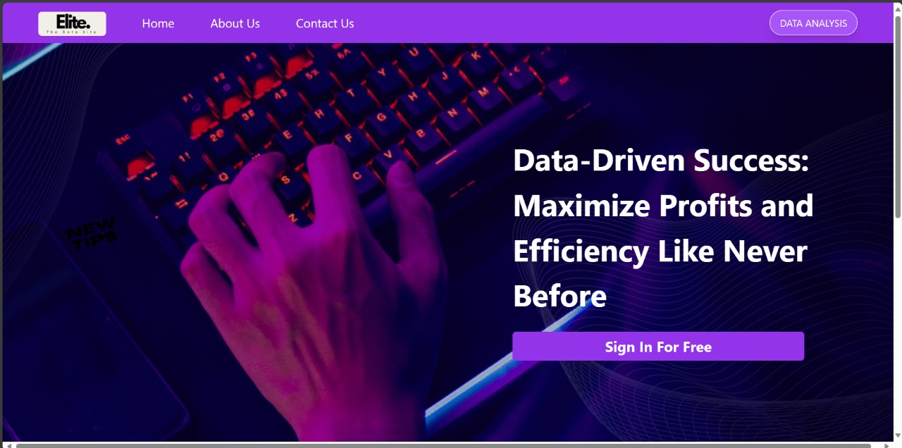
GET STARTED
First we will enter our local host 8000 which hosts our website.
After encountering the landing page, go to Data Analysis Tab.
After clicking, The page will redirect us to the Data Analysis page.

Slide 4
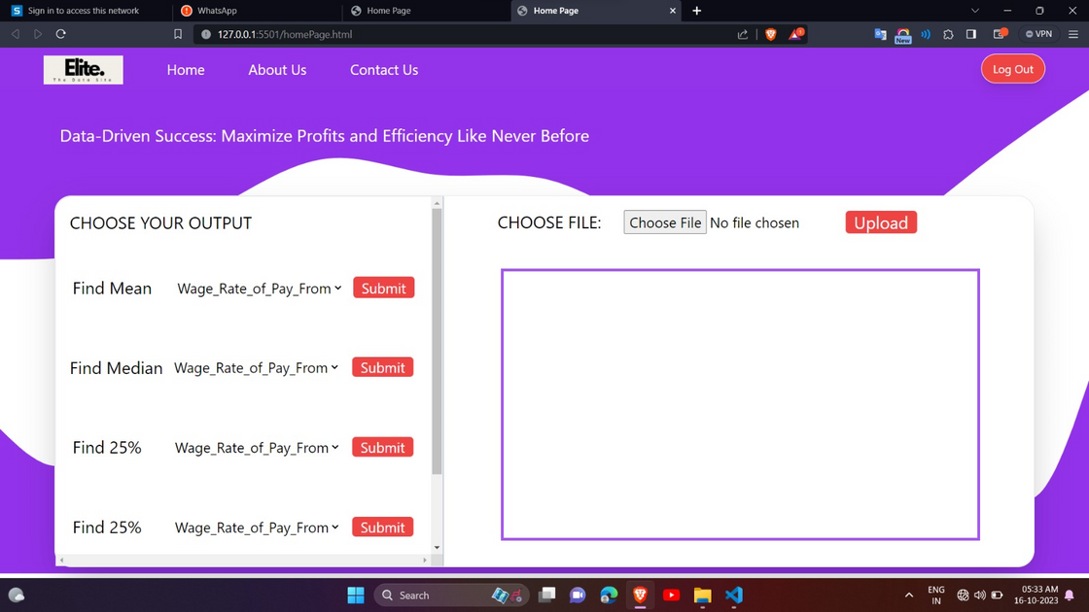
DATA ANALYSIS
STEP 1
After clicking on the Data Analysis button, this page shows up.
User will then select the desired Excel file or the CSV file.

Slide 5
STEP 2
After selecting the file, functions will be active and can be performed.
Click on the drop-down arrow of the function which user want to calculate.

Slide 6
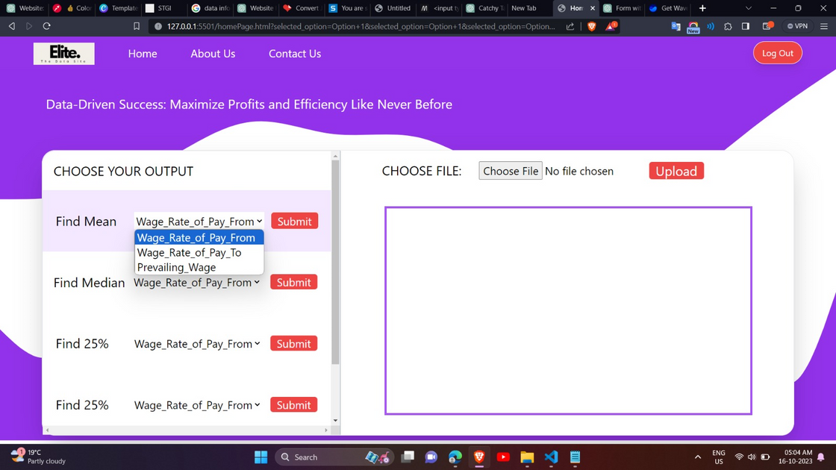
STEP 3
Select the desired column for which we want to evaluate the mean or any other function.
Click on Submit button.
Desired result will be displayed on right side.
MEAN

Slide 7






FUTURE SCOPE
VISUALIZATION
SAVED CHANGES
LOGIN/SIGNUP
We can add additional features like data visualization to efficiently read the data
User will be able to save the changes he made while analyzing the data
A login/signup feature can be added in order to authenticate the user and provide security to his work

Slide 8


REAL LIFE APPLICATIONS
Corporate Sector
Data Analysis with Django
Government Sector
Education Sector
A Product for the masses

Slide 9

THANK YOU

